Slide 1



Slide 2

BUSINESS ANALYTICS Introduction to Business Analytics and Core Business Functions
BUSINESS ANALYSIS Requirements Elicitation

Slide 3
Learning Objectives – WEEK 5
By the end of today you should be able to:
Understand how Business Analysts gather requirements
Choose the right elicitation technique for a situation
Conduct interviews and workshops effectively
Avoid common mistakes when talking to stakeholders

Slide 4
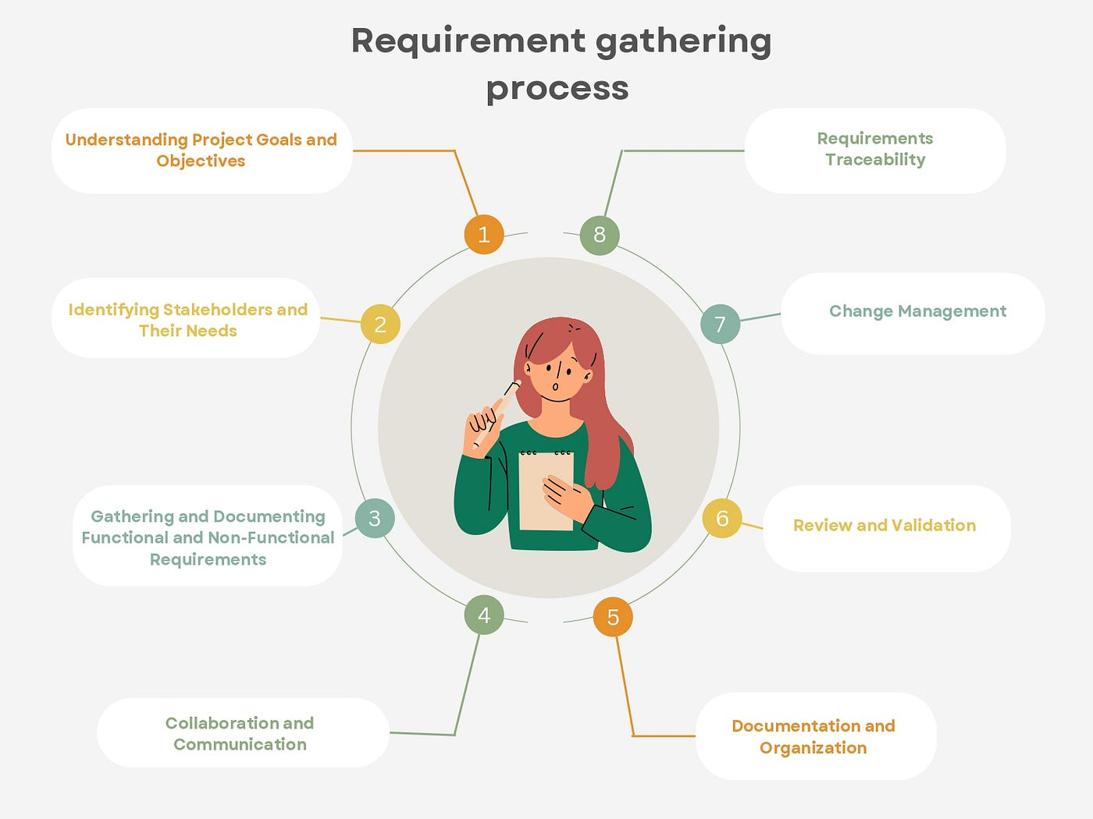

Slide 5
WHAT IS REQUIREMENTS ELICITATION?
Requirements elicitation = How we extract real needs from stakeholders.
Explain:
Stakeholders rarely give perfect requirements. BA must:
✔ Ask ✔ Observe ✔ Facilitate ✔ Clarify
Example
Banking Mobile App
Stakeholder says:
“Customers want faster payments.”
BA must dig deeper:
Faster compared to what?
Which screens slow?
Backend or UI issue?
Amazon Checkout Optimization
Stakeholders wanted: “Better checkout.”
BA conducted workshops + user observation → found users dropping off at shipping step.

Slide 6
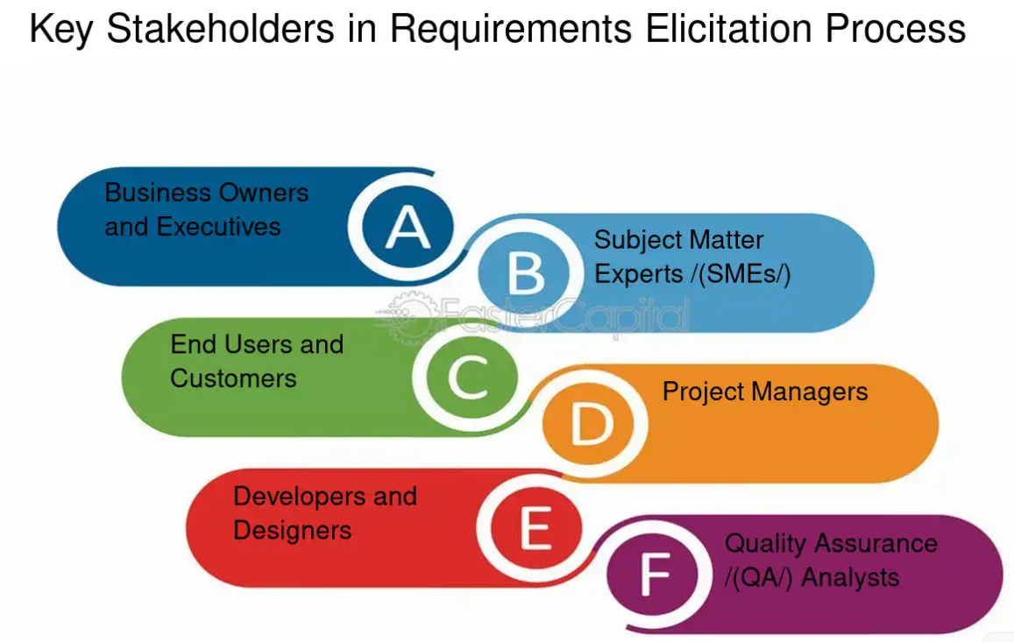

Slide 7
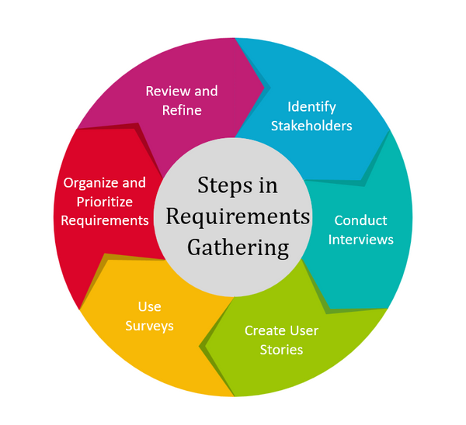
WHY ELICITATION IS CRITICAL
Most project failures happen because:
❌ Requirements assumed ❌ Stakeholders misunderstood ❌ Communication gaps
Developers build what is written — not what was intended.

Slide 8
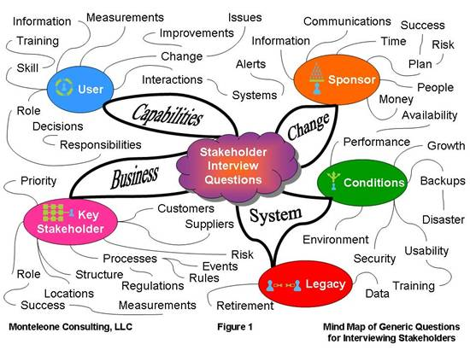
ELICITATION TECHNIQUE #1 – INTERVIEWS
What is an Interview?
One-on-one discussion to understand stakeholder needs.
Pakistan Example
BA interviews Jazz operations team to understand SIM activation flow.
International Example
Spotify BA interviews users about playlist usage.
🎯 How to Conduct Good Interviews
Teach students simple structure:
Start broad: 👉 “What challenges do you face daily?”
Probe deeper: 👉 “Why does this issue occur?”
Confirm understanding: 👉 “So your main problem is X, correct?”
❌ Common Mistake
Leading questions:
Bad: 👉 “You want dark mode, right?”
Good: 👉 “How do users prefer viewing content?”

Slide 9

ELICITATION TECHNIQUE #2 – WORKSHOPS
📌 What is a Workshop?
Group session to gather ideas and align stakeholders.
Pakistan Example
Fintech startup workshop with:
Developers
Marketing
Product Owner
Goal: Define MVP features.
🧠 Workshop Benefits
✔ Faster alignment ✔ Conflict resolution ✔ Shared understanding
International Example
Google design workshops using collaborative brainstorming.

Slide 10
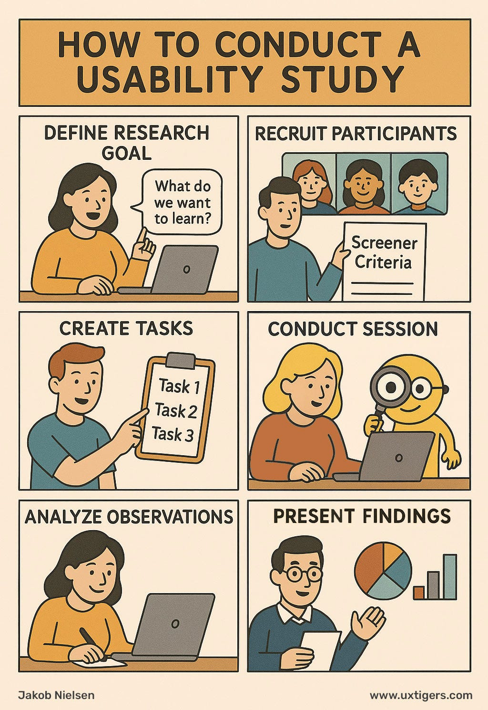
ELICITATION TECHNIQUE #3 – OBSERVATION
Sometimes stakeholders don’t know their own problems.
BA observes real workflows.
Pakistan Example
BA watches call center agents using CRM → discovers manual copy-paste process.
International Example
Uber observing driver app usage during peak hours.

Slide 11
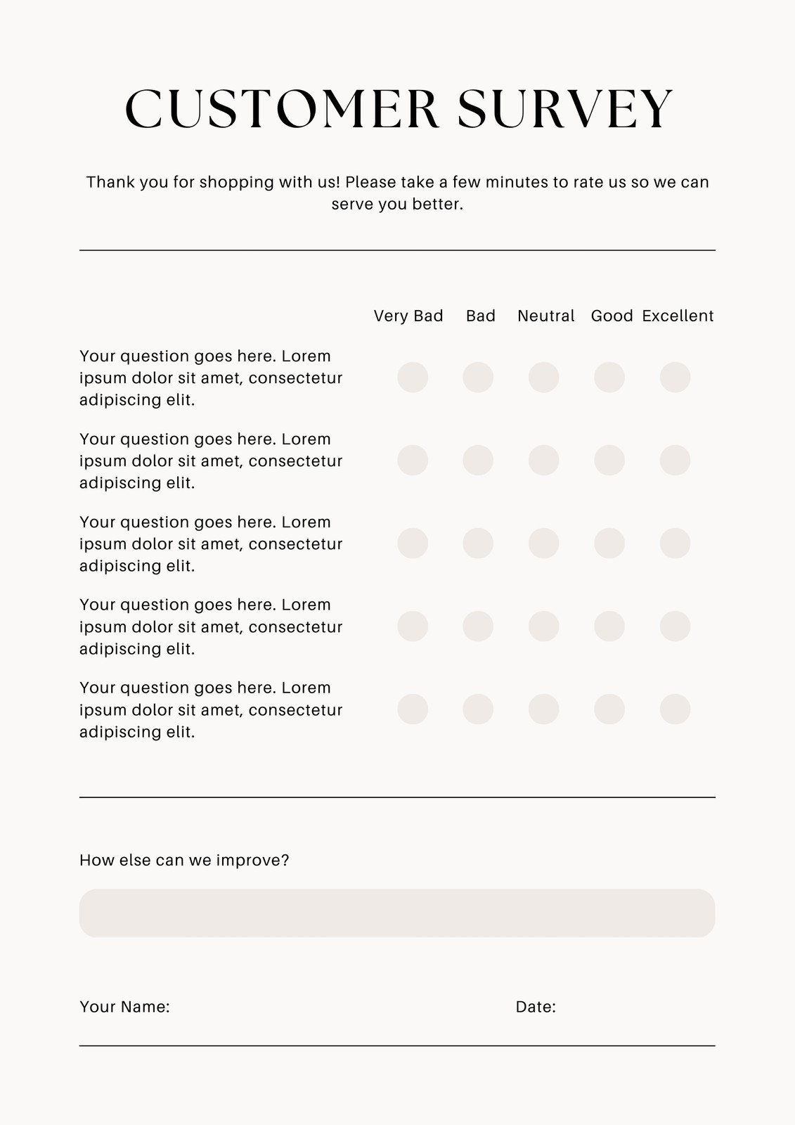
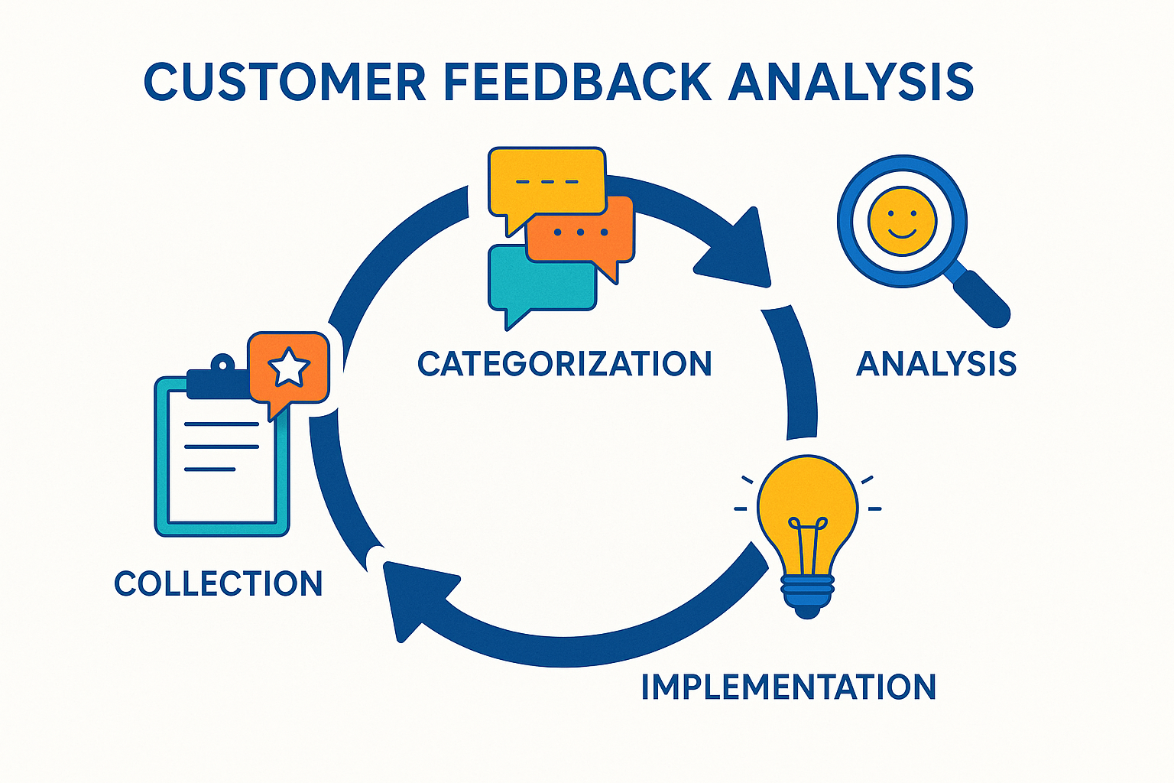
ELICITATION TECHNIQUE #4 – SURVEYS
Best when:
✔ Large audience ✔ Quick feedback needed
Pakistan Example
Daraz sends survey about delivery experience.
International Example
Netflix asks users to rate recommendations.
⚠️ Tip
Surveys are shallow — not deep understanding.
Use alongside interviews/workshops. Surveys = Wide reach Interviews = Deep insights

Slide 12
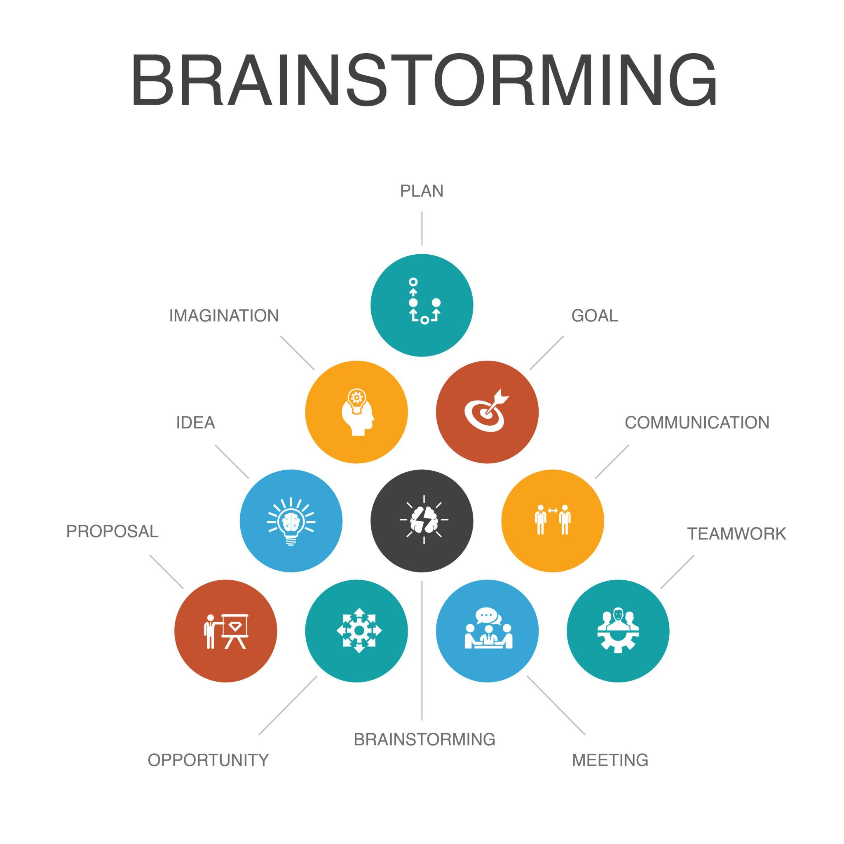
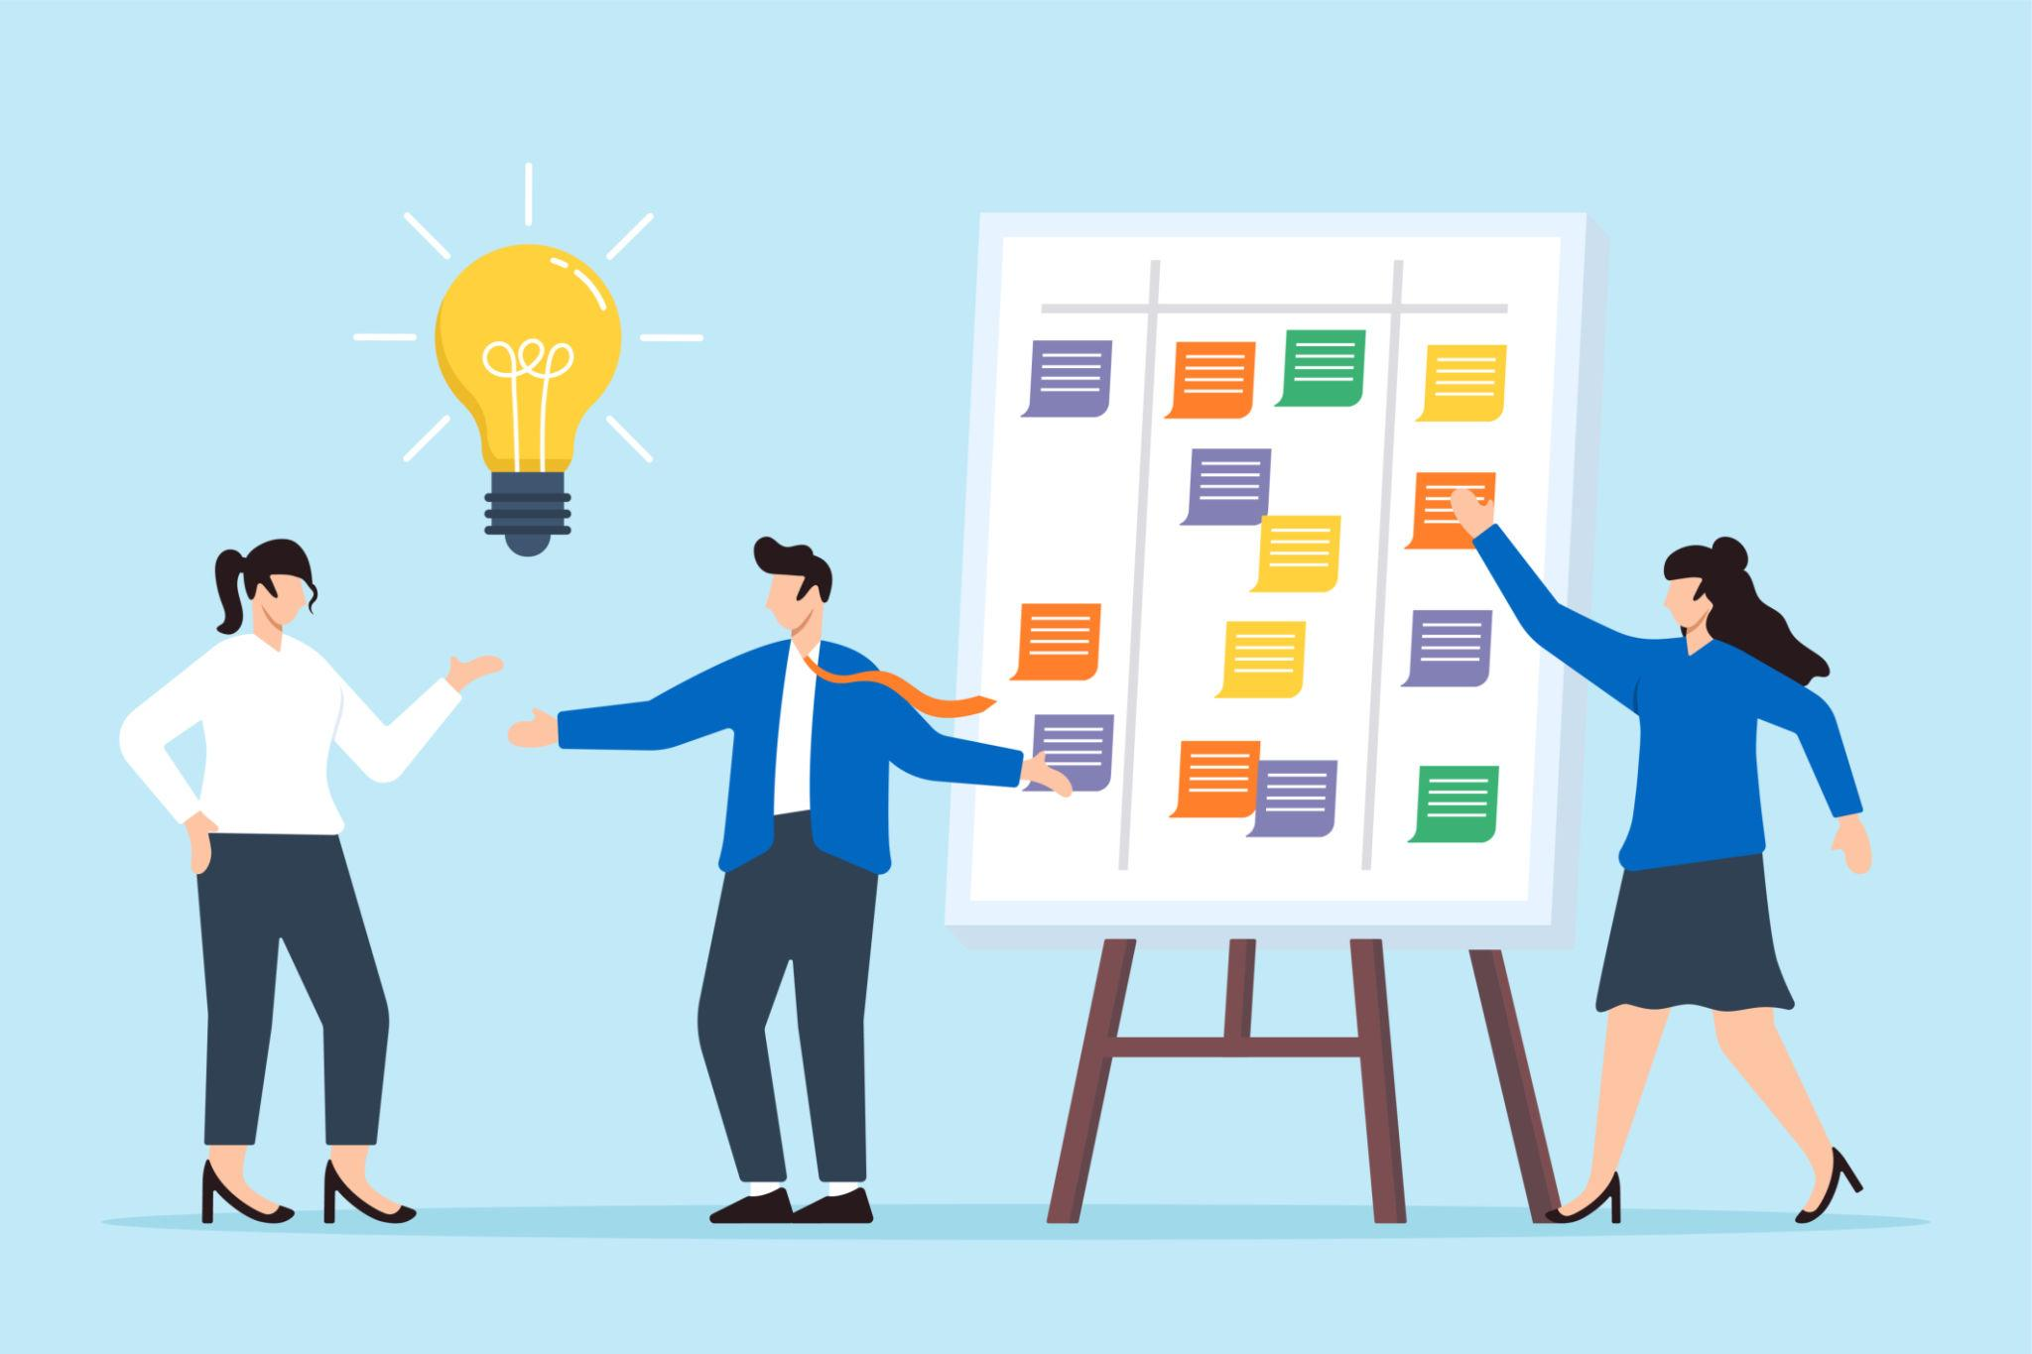
ELICITATION TECHNIQUE #5 – BRAINSTORMING
Idea generation session without judgment.
Pakistan Example
Startup brainstorming new features for Bykea app.
International Example
Apple product ideation sessions.
🧠 Brainstorming Rules
✔ No criticism initially ✔ Quantity over perfection ✔ Build on ideas

Slide 13
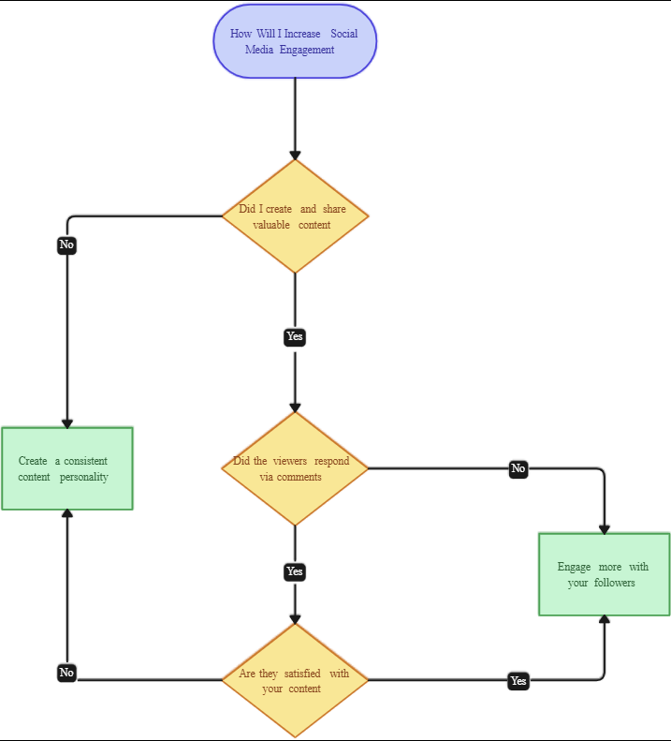
CHOOSING THE RIGHT TECHNIQUE (DECISION FRAMEWORK)
Situation | Technique
One expert stakeholder | Interview
Conflicting opinions | Workshop
Hidden workflows | Observation
Large user base | Survey
Innovation phase | Brainstorming

Slide 14
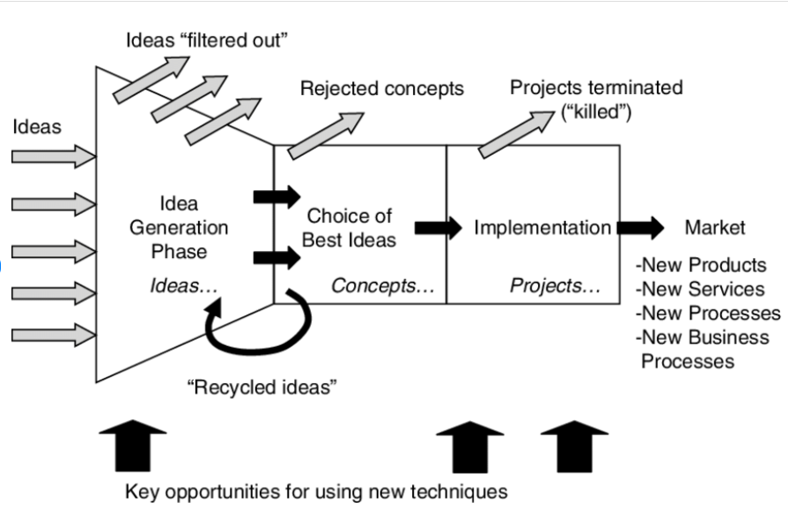
VISUAL ELICITATION FUNNEL MODEL
BA filters noise into structured requirements.

Slide 15
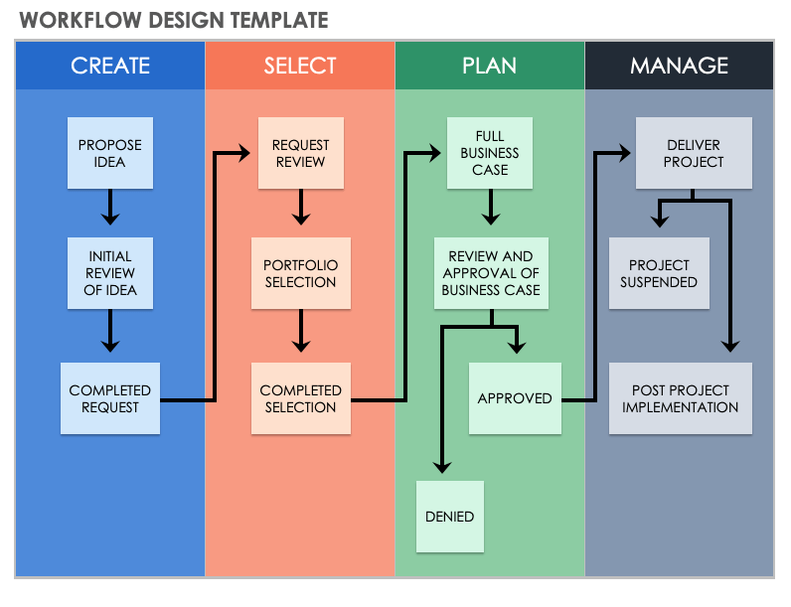
Client → “Make system modern.” BA → Ask probing questions.

Slide 16
KEY TERMINOLOGY STUDENTS MUST LEARN
Term | Definition | Main Purpose | Simple Example
Open-Ended Questions | Questions that require detailed answers instead of “yes” or “no.” | To gather deeper information and encourage discussion. | “What challenges do you face when using this system?”
Stakeholder Bias | When a stakeholder’s personal opinions or interests influence their judgment or decisions. | To recognize and manage unfair or one-sided viewpoints in projects. | A manager promotes features that only help their department.
Active Listening | Fully focusing on, understanding, and responding thoughtfully to what someone says. | To improve communication, trust, and clarity. | Nodding, paraphrasing, and asking clarifying questions.
Facilitation | Guiding a group discussion so participants collaborate effectively and reach outcomes. | To keep meetings productive and organized. | Leading a workshop to define project requirements.
Requirement Probing | Asking deeper follow-up questions to clarify or uncover hidden needs. | To ensure requirements are clear, complete, and accurate. | “What response time should the system have?”

